Slide 1
CI/CD Pipeline for Spring Projects with Jenkins and Docker Hub
Name: Atharva Kothawade
Date: 01/08/2024

Slide 2
Presentation Overview
Introduction to Spring Projects
Overview of CI/CD
Introduction to Jenkins
Setting Up Jenkins for Spring Projects
Building and Testing the Spring Project
Introduction to Docker
Dockerizing the Spring Application
Pushing Docker Images to Docker Hub

Slide 3

Introduction to Spring Projects
A powerful framework for building Java-based enterprise applications.
Provides support for dependency injection, transaction management, and more.
Simplifies Spring application development
with auto-configuration and
embedded servers.
Typical Spring Project Structure:
Main application class
Controllers, Services, Repositories
Configuration files

Slide 4

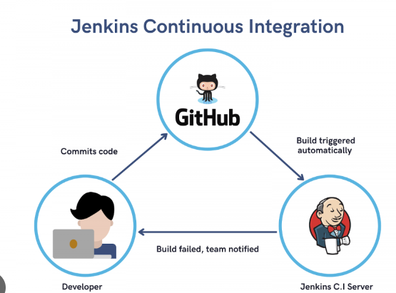
Overview of ci/cd Jenkins
Jenkins is a popular tool used for automating the software development process. It helps manage and automate tasks like building, testing, and deploying code. Think of it as a robot that helps developers by handling repetitive tasks and making sure code changes are tested and delivered smoothly.
Continuous Integration (CI): Developers frequently add their code to a shared repository. Automated tests are run to make sure the new code doesn’t break anything. This helps catch problems early.
Continuous Delivery (CD): After code is integrated and tested, it’s automatically prepared for release. This means it can be deployed to users quickly and reliably.

Slide 5
Setting Up Jenkins for Spring Projects
Title: Configuring Jenkins for Spring CI/CD Content:
Installation:
Download Jenkins from the official site and follow the installation instructions for your OS.
Set up Jenkins on your server or local machine.
Creating a Jenkins Job:
Freestyle Project: For simple configurations, where you can specify build steps, test results, and deployment.
Pipeline Project: For complex workflows, using a Jenkinsfile to define the CI/CD pipeline in code.
Configuration:
Source Code Repository: Connect Jenkins to your Git repository.
Build Triggers: Set up triggers like commits, pull requests, or scheduled builds.

Slide 6
Building and Testing the Spring Project
Build Configuration: (Building with Jenkins)
Use Maven or Gradle to compile and package your Spring application.
Configure build steps in Jenkins:
For Maven: mvn clean install
For Gradle: gradle build
Testing:
Unit Tests: Ensure individual components work correctly.
Integration Tests: Verify that components work together as expected.
Configure Jenkins to run tests and report results, using plugins to display test results and code coverage

Slide 7
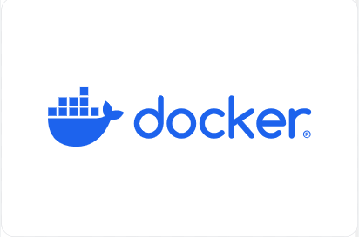
INTRODUCTION TO docker
Docker lets you build, test, and deploy applications quickly Using Docker, you can quickly deploy and scale applications into any environment and know your code will run. Running Docker on AWS provides developers and admins a highly reliable, low-cost way to build, ship, and run distributed applications at any scale.

Slide 8
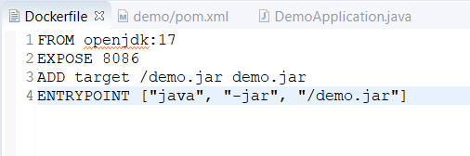
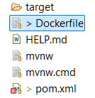
Dockerizing the Spring Application
Dockerfile:
Base Image: Start with an official Java base image (e.g., openjdk).
Add Application: Copy your Spring Boot JAR file into the image.
Expose Port: Define the port the application will run on.
Command to Run: Specify the command to run your Spring Boot application

Slide 9
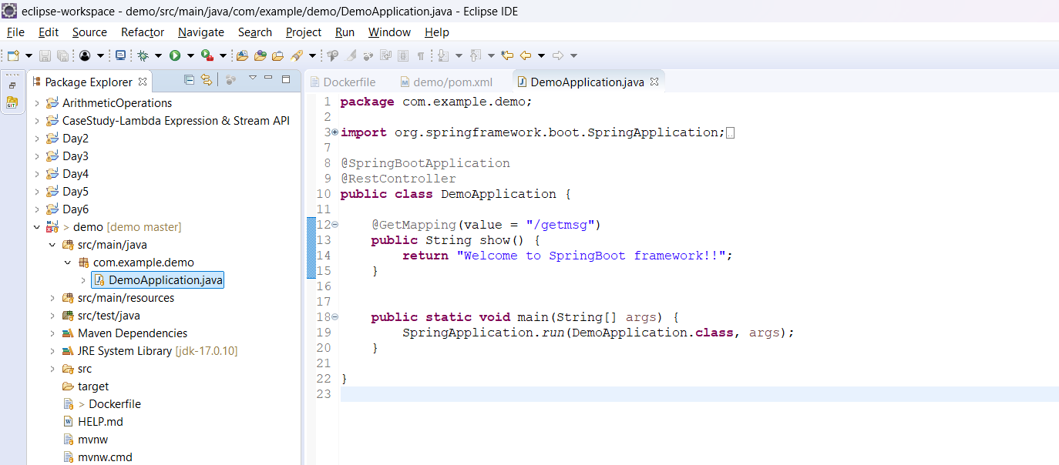
Project images

Slide 10
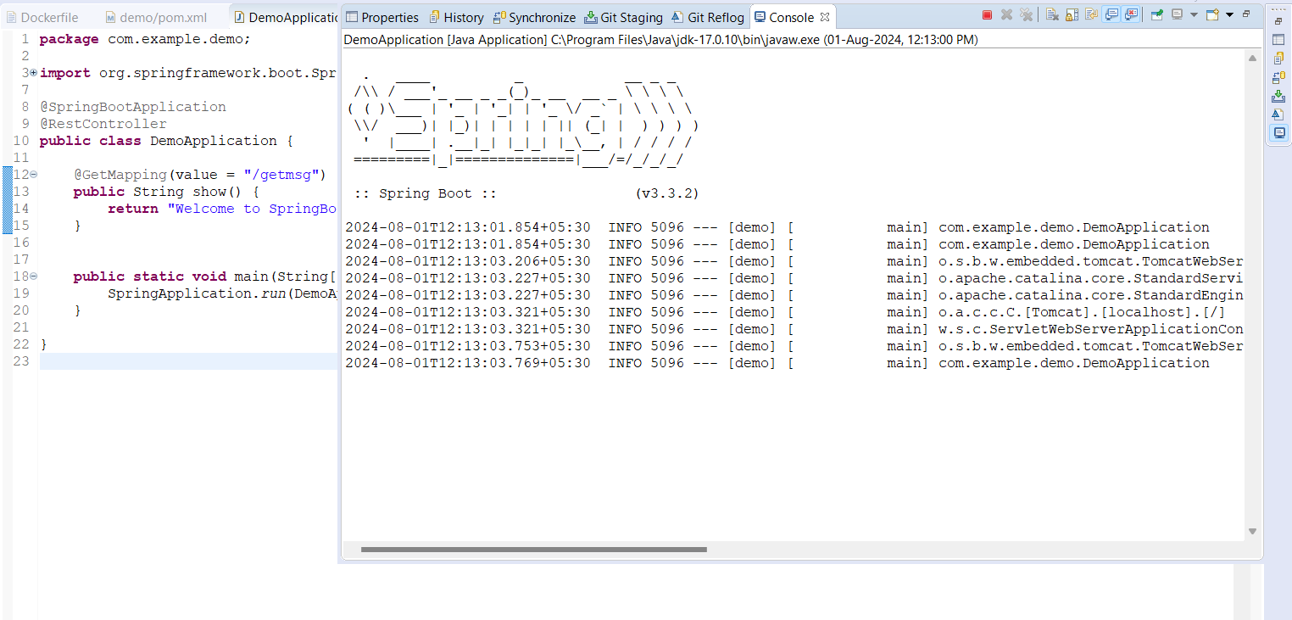

Slide 11
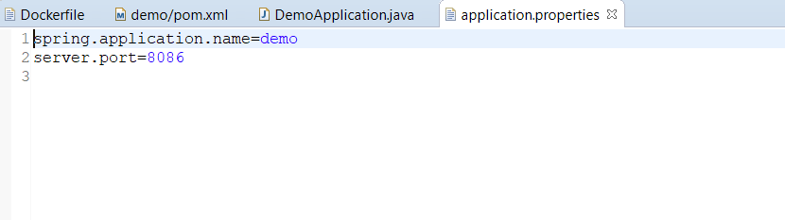
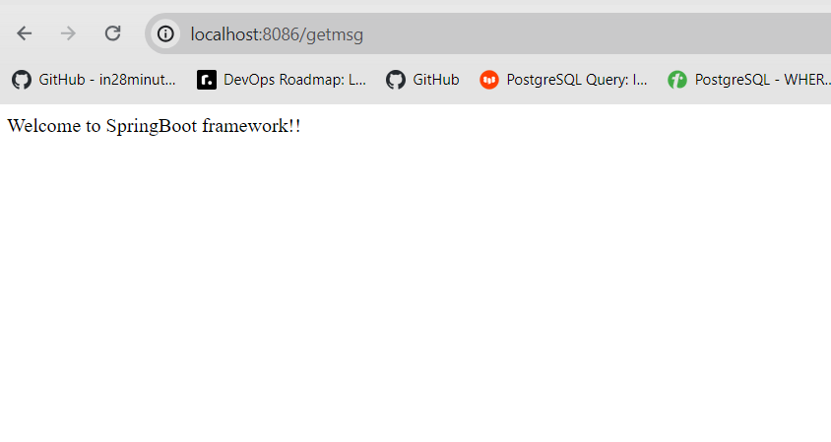

Slide 12
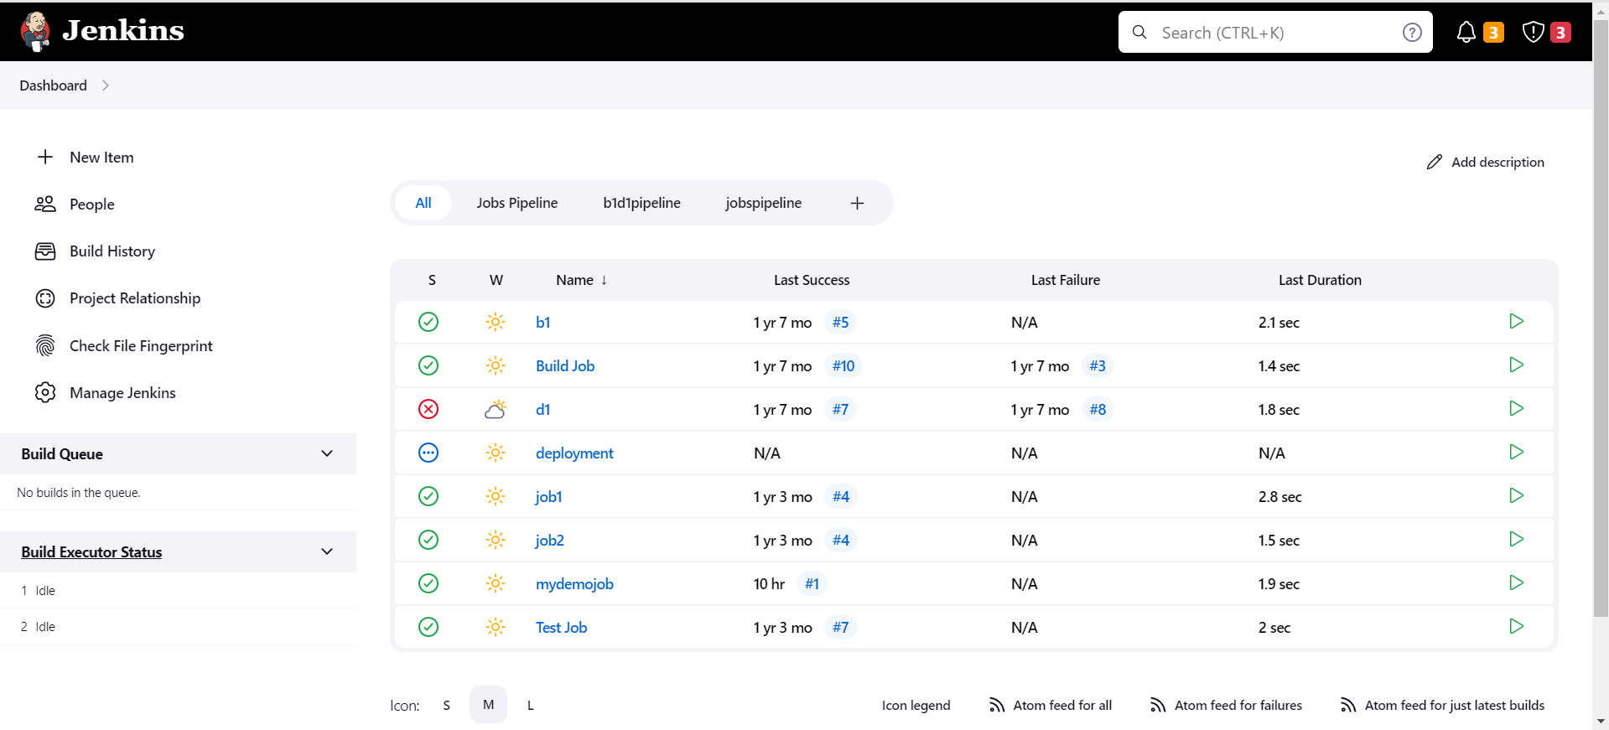

Slide 13
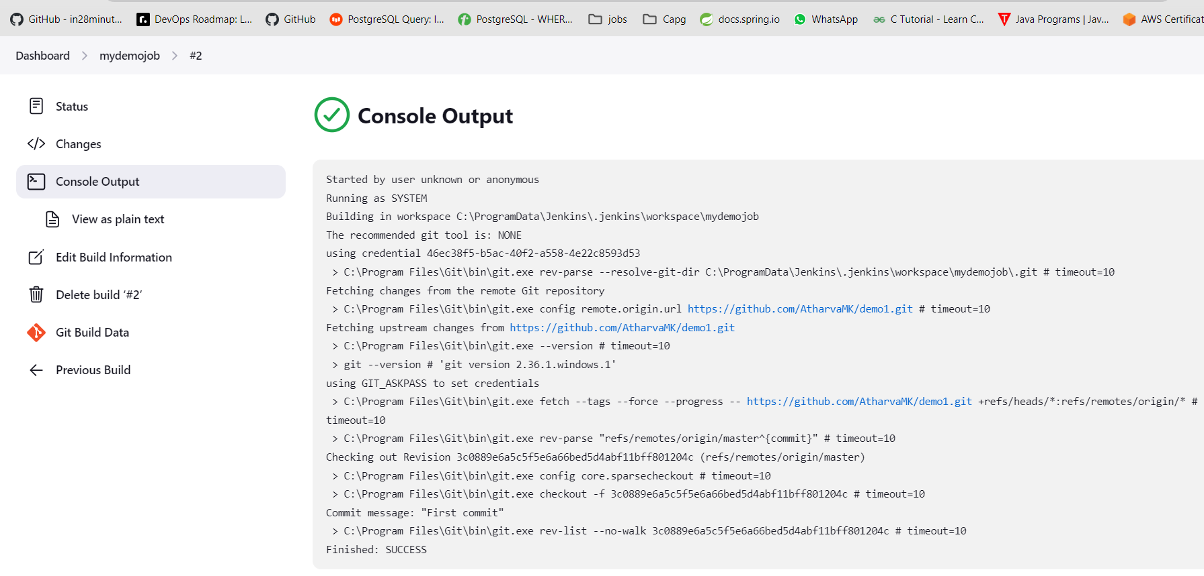

Slide 14
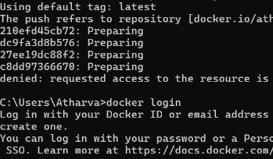
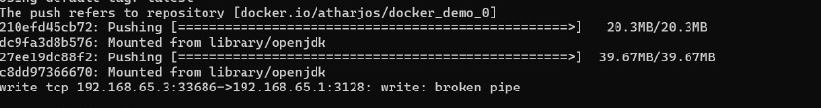
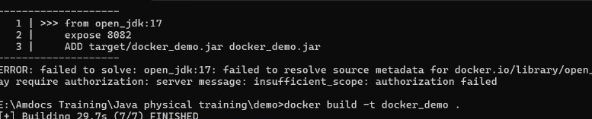

Slide 15
Thank you

